Slide 1



WaM-DaM: A Data Model to Organize, Share, and Publish Water Management Data
Water and Environ. Eng. Grad Seminar
Adel M. Abdallah
Major Advisor: David Rosenberg
April 3rd, 2014

Slide 2

Water Management Data Model (WaM-DaM)
Why Do We Need a Standard?
Design Methods
WaM-DaM
Results
Conclusions
A New Method/Standard to Organize Network-Based Water Management Data
WaM-DaM
Model quicker. Publish faster.
Notes:
The overarching contribution is: a New standard/method to organize network-based water management data
Benefits
Give examples for these benefits
Compare sources
Handle big data
Provide big picture
One place for all!

Slide 3

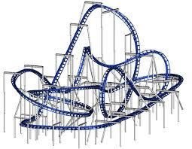
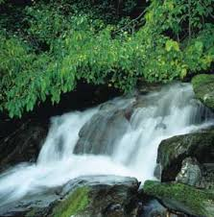
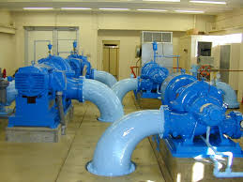
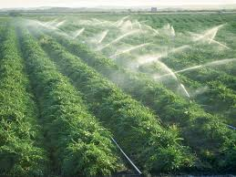
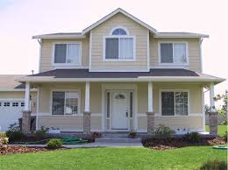
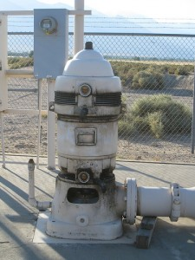
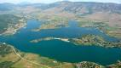

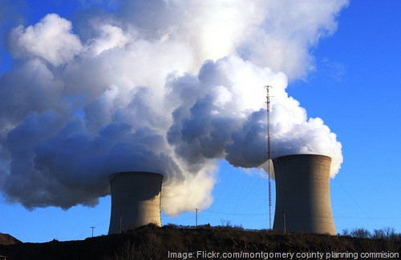
Why Do We Need a Standard?
We use different data sources and models to allocate limited and variable water supplies to meet competing demands
Scientists and managers spend a considerable time to build these models (up to 75% of their time)
Supply
Demand
Notes:
Spend 30 seconds on this slide

Slide 4
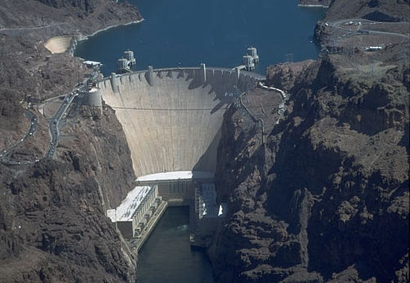




Different Sources and Descriptions
Hoover Dam
Lake Mead
e.g., release
e.g., outflow
Reservoir? Water body?
HydroDesktop
Notes:
Spend 30 seconds on this slide

Slide 5
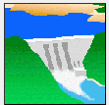




Different Model Needs
Reservoir Simulation (ResSim)
Simulates reservoir operation and management
Requires operational data (e.g., gates and release rules), river network, diversions, etc.
Water Evaluation and Planning system (WEAP)
Allocates water supply and demand in a river basin
Requires supply and demand connectivity and flows, economic data, water quality, allocation priorities, etc.

Slide 6
Objective
Design a data model/standard to organize, share, and publish water management data
Should be: Open-source, generic, programming language and technology independent
WaM-DaM
Model quicker. Publish faster.

Slide 7

What is a Data Model?
Represents real world objects as entities with their attributes and relationships
Instances
Tweet:
I support Hyrum #reservoir #LittleBearRiv.Rest.
Projects
Objects
[1]
[10]
[1]
e.g., Reservoir [1]
e.g., Little Bear River Restoration Project
[10]
e.g., Hyrum [10]
Notes:
Right a full tweet and add tweeter logo show a real example from WaM-DaM schema

Slide 8
Design Methods
1. Identify the essential data for water management. 170 fields
2. Represent these fields in tables according to Relational Model Theory and Jim Gray’s rule. 36 Tables
Notes:
The blue line boarder focuses on the existing ODM standard for time series data

Slide 9
WaM-DaM Schema
Notes:
This figures shows how the 170 columns are represented in 36 tables (boxes) under five themes: Project metadata, network metadata,
Controlled vocabulary, attribute metadata and data values storge

Slide 10

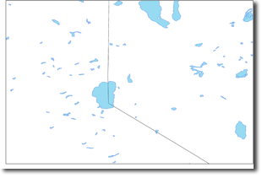
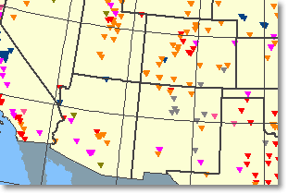

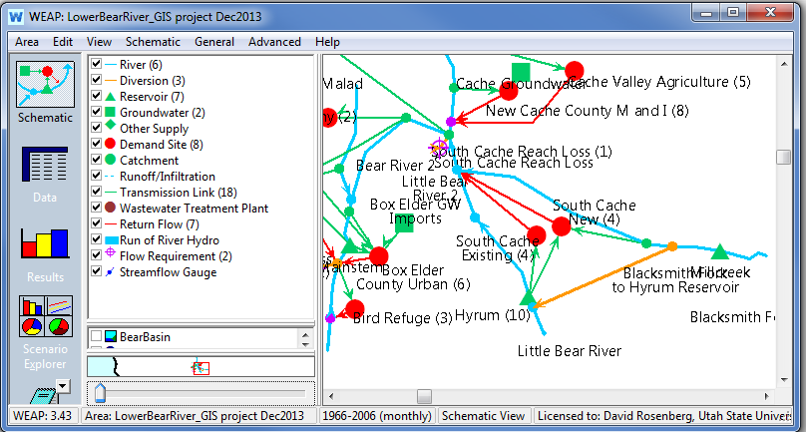
Load Different Data to WaM-DaM
US Dams dataset
US Water Bodies and Wetlands Dataset
Time Series data
WEAP Model
Lower Bear River, UT
Notes:
Focus more on WEAP model as a data source of networks for WaM-DaM

Slide 11
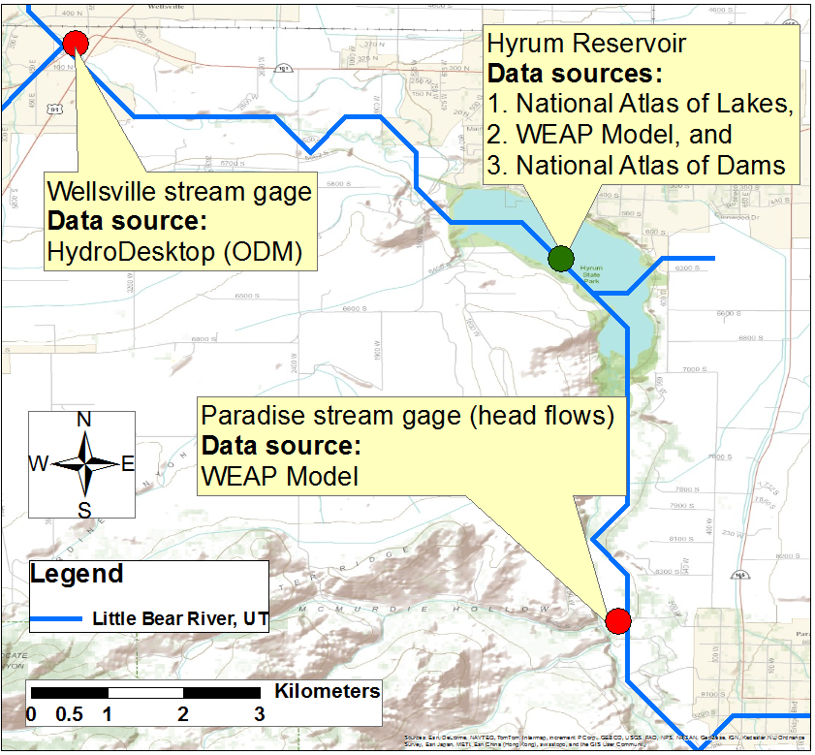
Represent the Little Bear River Network, Utah in WaM-DaM

Slide 12

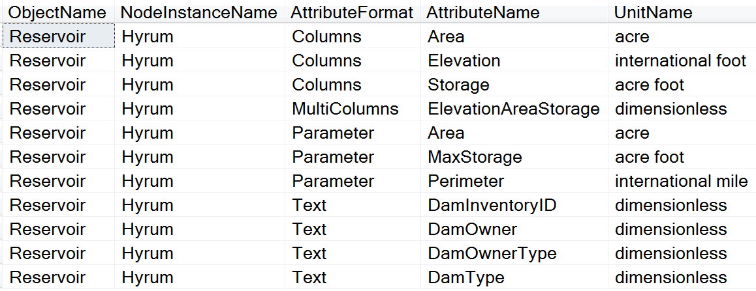
Results: Give me all the attributes for Hyrum Reservoir and their units?
Dam, Reservoir, water body, lake
Object name
Node instance name
Attribute format
Attribute name
Unit name
Notes:
Reduce this table to only 4 rows where each one shows an attribute format example

Slide 13
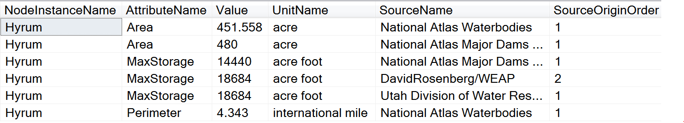
Results: Give me the values of the area and MaxStorage attributes in Hyrum Reservoir with their units and sources?
Node instance name
Attribute name
Value
Unit name
Source
MAX_STOR and Total Capacity

Slide 14
Future Work
Refine the data model design
Automate data discovery, loading, and retrieval
Test WaM-DaM with larger networks and national datasets
Use WaM-DaM to populate and run models
Notes:
Spend a bit of time on this figure and mention my recommendation of implementing this with CUHASI Use larger font

Slide 15
Conclusions
Proposed WaM-DaM as a standard to organize, share, and publish water management network-based data
Organize data like time series, text, multi-column, and parameters for a simple network from different sources
WaM-DaM can foster integrated understandings of water systems and data analysis that was not previously possible
Future work will automate the process to discover, transform, and publish of data plus use larger networks and populate and run models

Slide 16
Thank you!
Questions?
WaM-DaM
Model quicker. Publish faster.

Slide 17
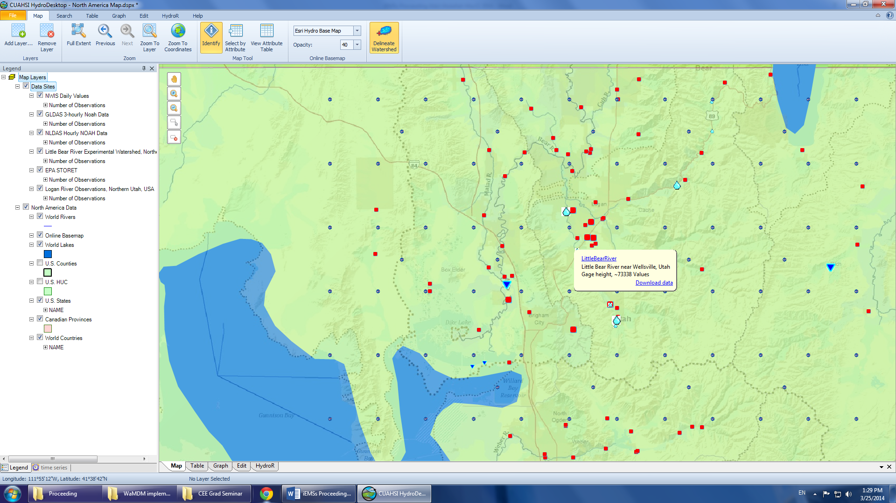
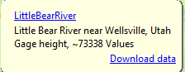
Discover time series data! (HydroDesktop)

Slide 18
How Does WaM-DaM Work?
1) Object
2) Instances
3) Data Values
Hyrum
Time series, cfs, PacifiCorps, gage height, average, etc
Reservoir:
Name
Inflow
Capacity
Owner
Bathymetry
First Dam
MultiColum, elevation, storage, area, WaterLab, etc
Notes:
Transition to moving data to WaM-DaM in a case study

